Slide 1


B.TECH MINOR PROJECT PRESENTATION 2025-2026
Smart Diabetes Prediction & Management
Sophitorium Engineering College
Student 1:
Roll No:
Student 1:
Roll No:
Student 1:
Roll No:
Student 1: Laxmi Kanta Panda
Roll No: 2301332012
Under the guidance of
Prof. Nabin Kumar Nag

Slide 2
B.TECH MINOR PROJECT PRESENTATION 2025-2026
Introduction
Objective
Problem statement
Methodology
Algorithm
Results till date
Reference
CONTENTS
Sophitorium Engineering College
Laxmi Kanta Panda (2301332012)

Slide 3
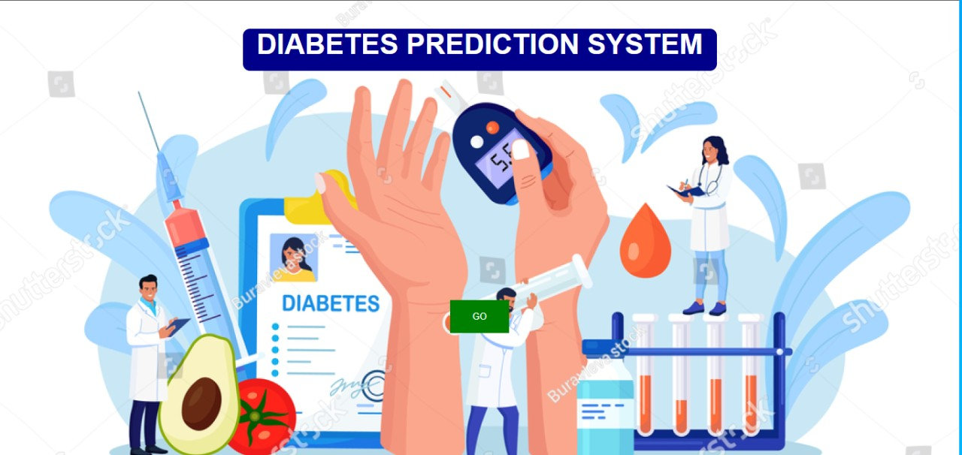
B.TECH MINOR PROJECT PRESENTATION 2025-2026
INTRODUCTION
Smart diabetes prediction and management systems leverage machine learning algorithms to analyze patients' health data and provide personalized recommendations. Patients input data like blood glucose levels, skin thickness, age, blood pressure, Blood pressure , Insulin level and other relevant health metrics. The system processes this data to assess the likelihood of diabetes or complications. Based on risk levels, it provides immediate guidance on whether to consult a doctor. By automating routine monitoring, these systems help individuals manage their condition proactively, reducing complications and supporting timely medical intervention.
Sophitorium Engineering College
Laxmi Kanta Panda (2301332012)

Slide 4
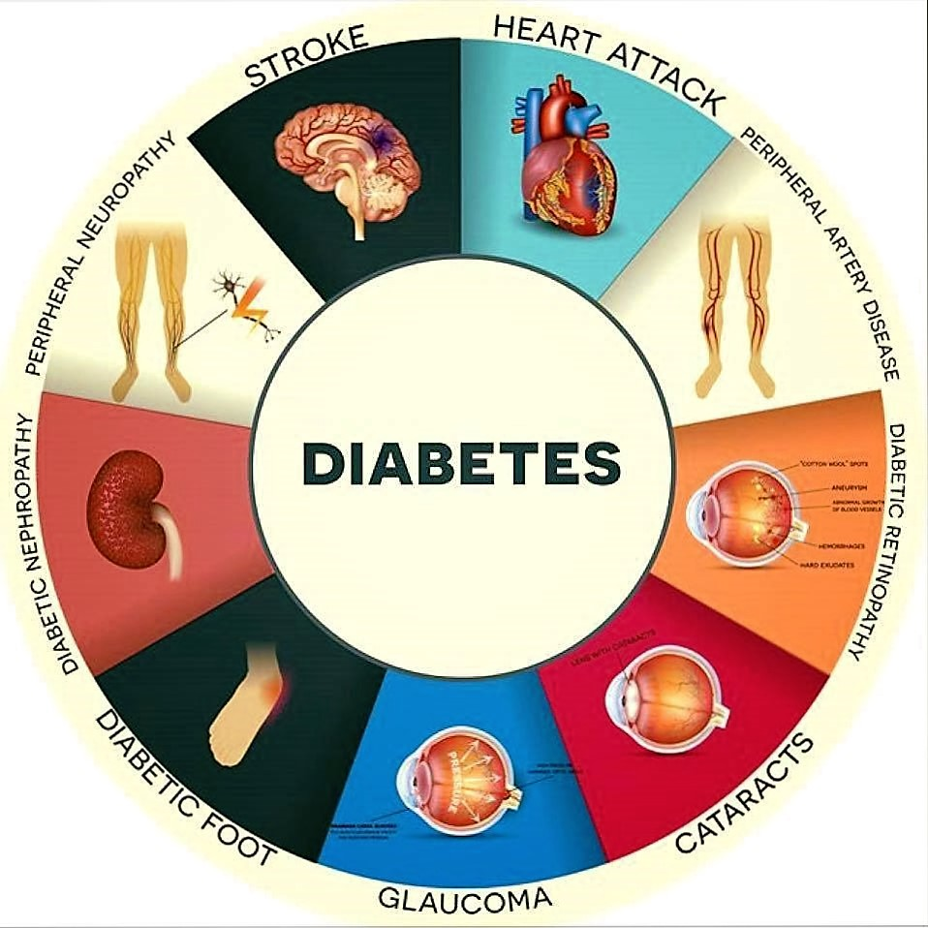
B.TECH MINOR PROJECT PRESENTATION 2025-2026
OBJECTIVE
This project uses smart technology to predict who might get diabetes by analyzing health data.
By spotting those at high risk early, the system helps doctors and patients take action sooner and provide care that's tailored to each person
Sophitorium Engineering College
Laxmi Kanta Panda (2301332012)

Slide 5
B.TECH MINOR PROJECT PRESENTATION 2025-2026
PROBLEM STATEMENT
Create a smart system that can predict the risk of diabetes and help manage it better. The goal is to use data to give personalized advice and improve health outcomes.
Develop an intelligent system to predict and manage diabetes effectively through data-driven insights and personalized recommendations.
Sophitorium Engineering College
Laxmi Kanta Panda (2301332012)

Slide 6
B.TECH MINOR PROJECT PRESENTATION 2025-2026
METHODOLOGY
Data Collection :Gather relevant data from patients, including blood sugar levels, weight, diet, exercise habits, and medical history.
Data Preprocessing: Clean and organize the data, handling missing values and outliers.
Feature Engineering: Create new features or transform existing ones to improve model performance.
Model Selection:Choose appropriate machine learning algorithms (e.g., random forest, neural networks) for prediction and management.
Model Training: Train the selected models using the prepared data.
Model Evaluation: Assess the model's accuracy, precision, recall, and F1-score to ensure its reliability.
Prediction: Use the trained model to predict future blood sugar levels or the risk of diabetes-related complications.
Management : Develop personalized management plans based on the predictions, providing recommendations for diet, exercise, medication, and lifestyle changes.
Sophitorium Engineering College
Laxmi Kanta Panda (2301332012)

Slide 7
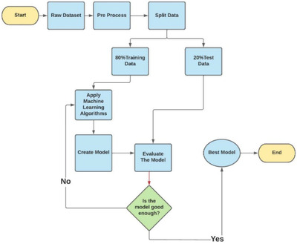
B.TECH MINOR PROJECT PRESENTATION 2025-2026
METHODOLOGY
Sophitorium Engineering College
Laxmi Kanta Panda (2301332012)

Slide 8
B.TECH MINOR PROJECT PRESENTATION 2025-2026
METHODOLOGY
Sophitorium Engineering College
Laxmi Kanta Panda (2301332012)

Slide 9
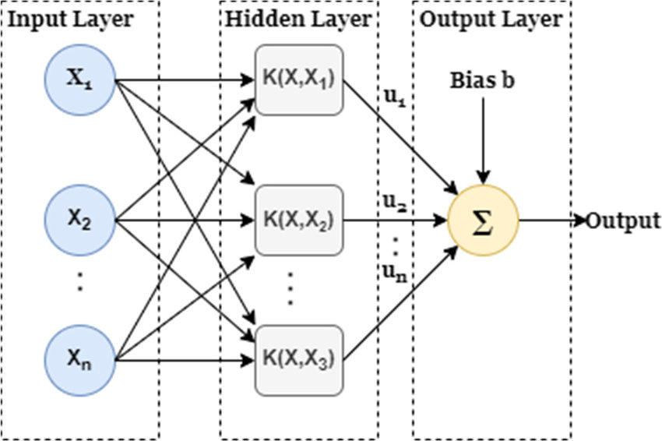
B.TECH MINOR PROJECT PRESENTATION 2025-2026
ALGORITHM
SVMs are commonly used within classification problems.
They distinguish between two classes by finding the optimal hyperplane that maximizes the margin between the closest data points of opposite classes.
The number of features in the input data determine if the hyperplane is a line in a 2-D space or a plane in a n-dimensional space.
Sophitorium Engineering College
Laxmi Kanta Panda (2301332012)

Slide 10

B.TECH MINOR PROJECT PRESENTATION 2025-2026
RESULTS TILL DATE
SVM in Smart Diabetes Prediction and Management leverages machine learning to identify high-risk individuals early, facilitating timely interventions. It offers data-driven insights for personalized care, helping clinicians create tailored preventive strategies. When paired with wearable technology, it enables continuous health monitoring and proactive adjustments, improving outcomes and reducing costs in diabetes care.
Sophitorium Engineering College
Laxmi Kanta Panda (2301332012)

Slide 11
B.TECH MINOR PROJECT PRESENTATION 2025-2026
REFERENCE
S. Li et al., "Diabetes Prediction and Management Using Mobile Health Technology," Journal of Healthcare Informatics Research, 2022.
Abhishek Sharma et al., “Predicting Diabetes Using K-Nearest Neighbors and Its Evaluation Using Different Validation Techniques,” Procedia Computer Science, 2020.
Smitha Sundararajan, “mHealth App for Diabetes Prediction Using KNN and User Lifestyle Data,” Journal of Healthcare Informatics Research, 2021.
4. L. Zhang et al. “Machine Learning Approaches in Diabetes Prediction and Management,” IEEE Access, 2021.
5. M. Patel, J. McNeil. “Integrating Machine Learning and Wearable Devices for Personalized Diabetes Management,” Journal of Medical Internet Research, 2021.
Sophitorium Engineering College
Laxmi Kanta Panda (2301332012)

Slide 12
B.TECH MINOR PROJECT PRESENTATION 2025-2026
Thank You
Sophitorium Engineering College
Laxmi Kanta Panda (2301332012)

